Slide 1
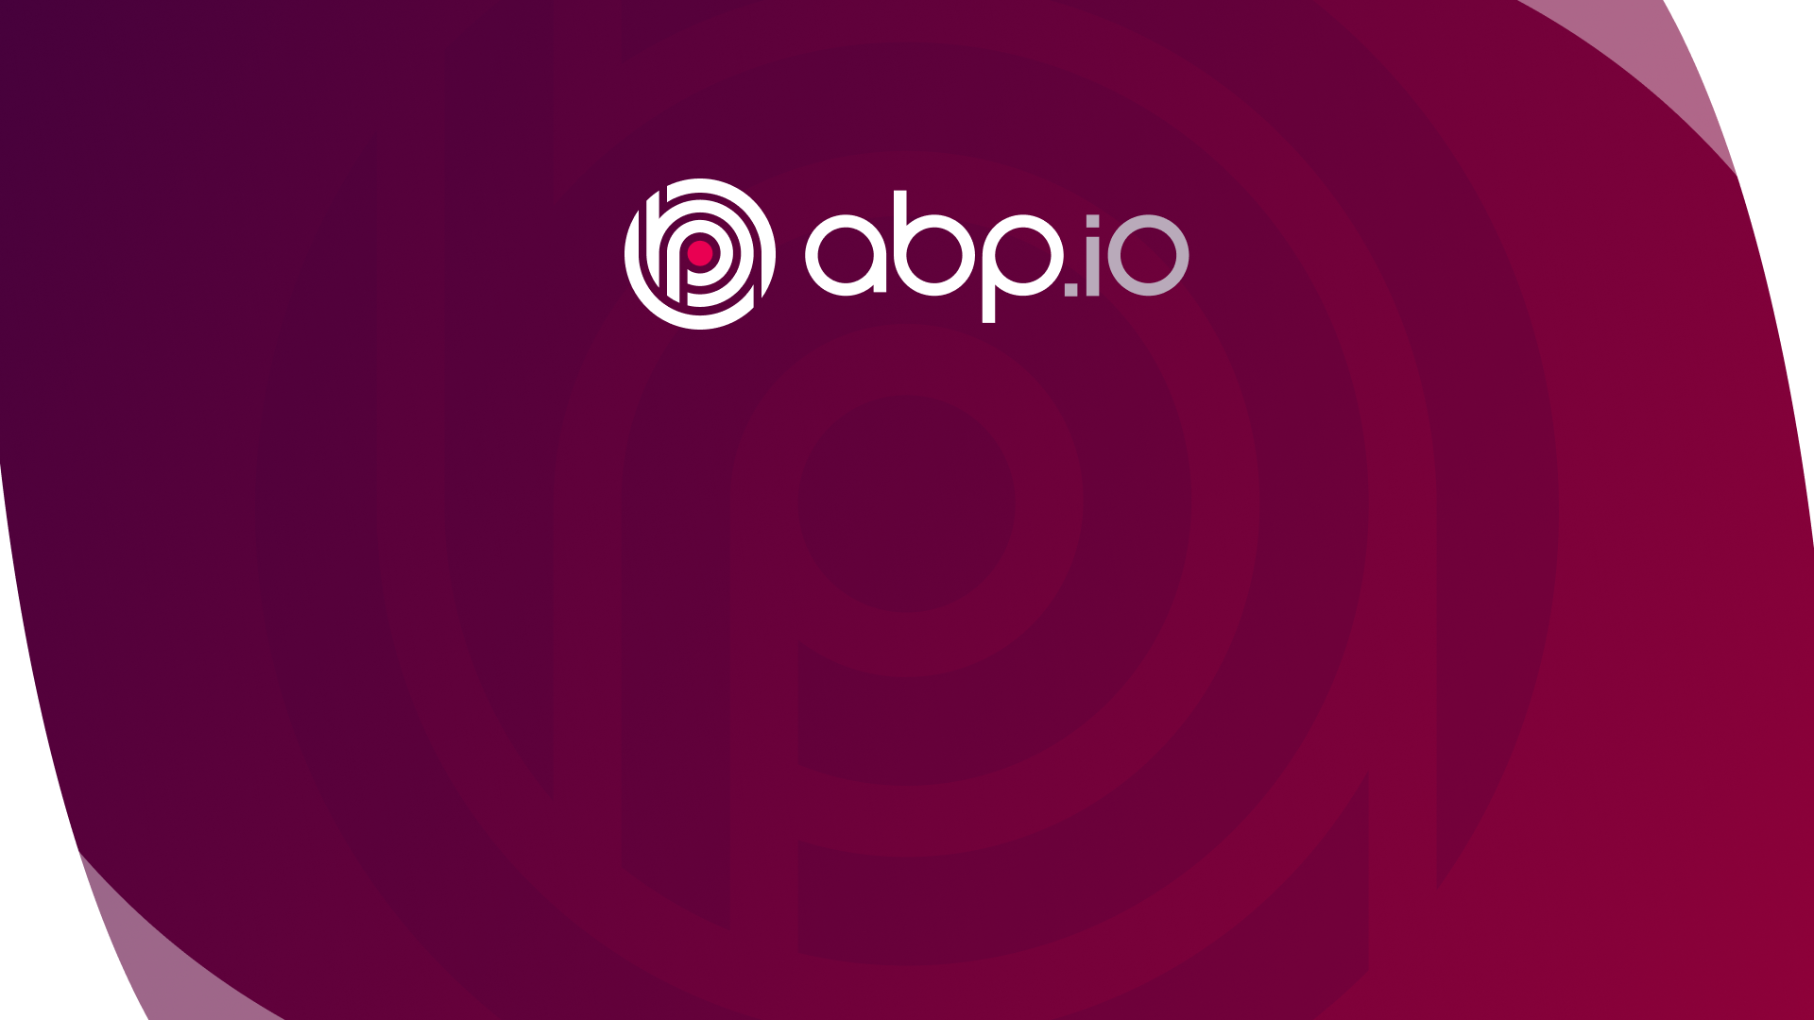
Microservice Communication with the ABP Framework
Halil İbrahim KALKAN https://halilibrahimkalkan.com
https://github.com/hikalkan/presentations
www.abp.io

Slide 2
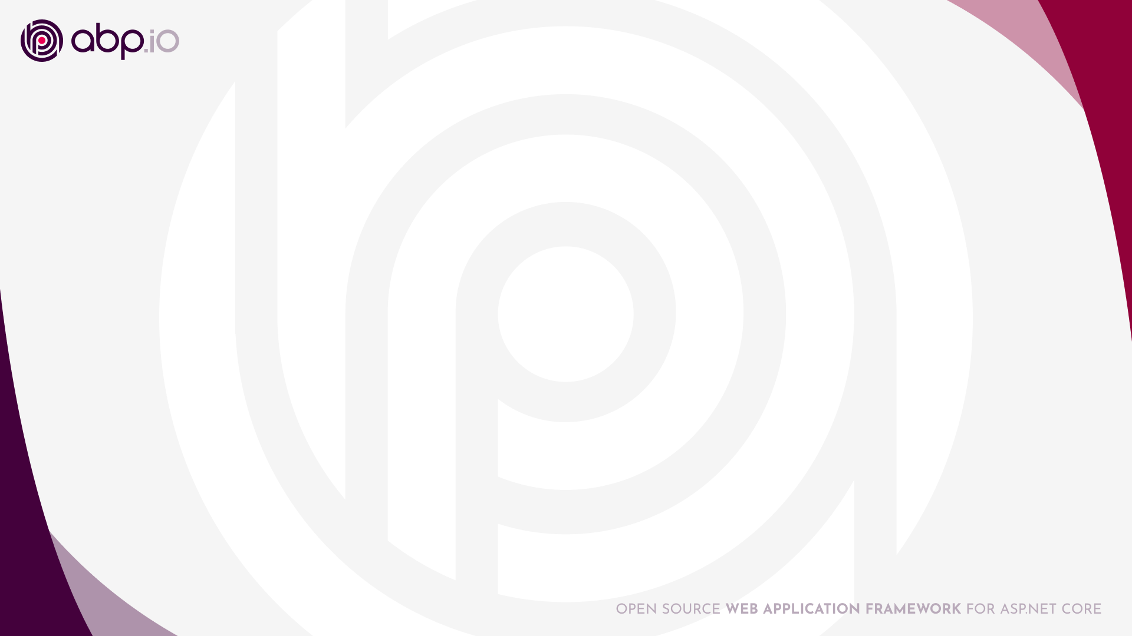
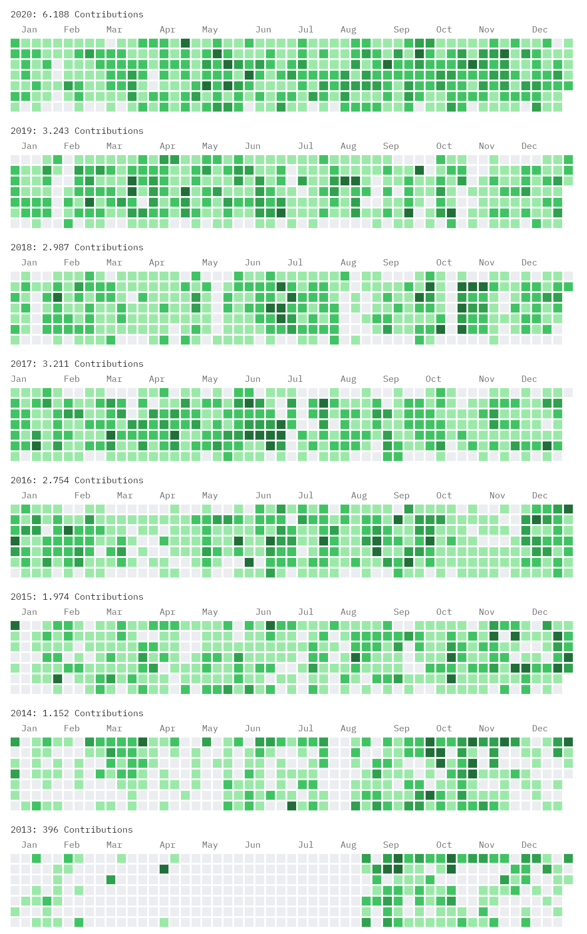
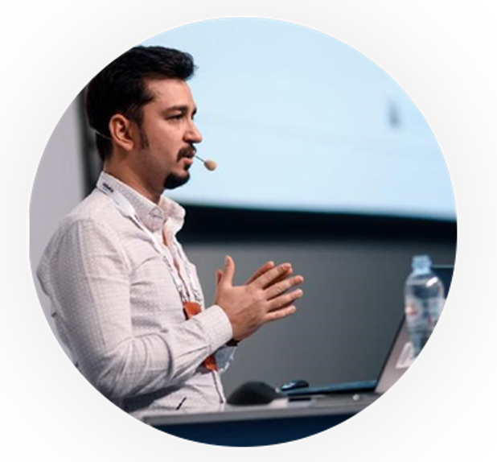

About me
Halil İbrahim Kalkan
Co-Founder of
Web: halilibrahimkalkan.com
Github: @hikalkan
Twitter: @hibrahimkalkan

Slide 3

What is the ABP Framework?
ABP fills the gap between the plain ASP.NET Core and enterprise software requirements.
Offers a modern and maintainable software architecture.
Provides the necessary infrastructure, tooling and documentation implement that architecture.
A great community contributes and discusses that architecture!
Working on the latest .NET..!
Your Application
(plain) ASP.NET Core

Slide 4
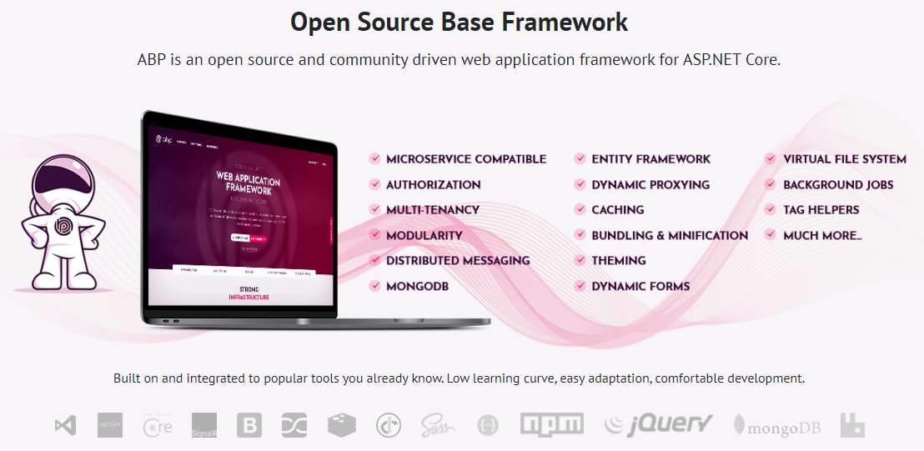

Slide 5
The architecture
Domain Driven Design
& Layered Solution
Modular
Multi-Tenancy (SaaS infrastructure)
Microservice ready

Slide 6
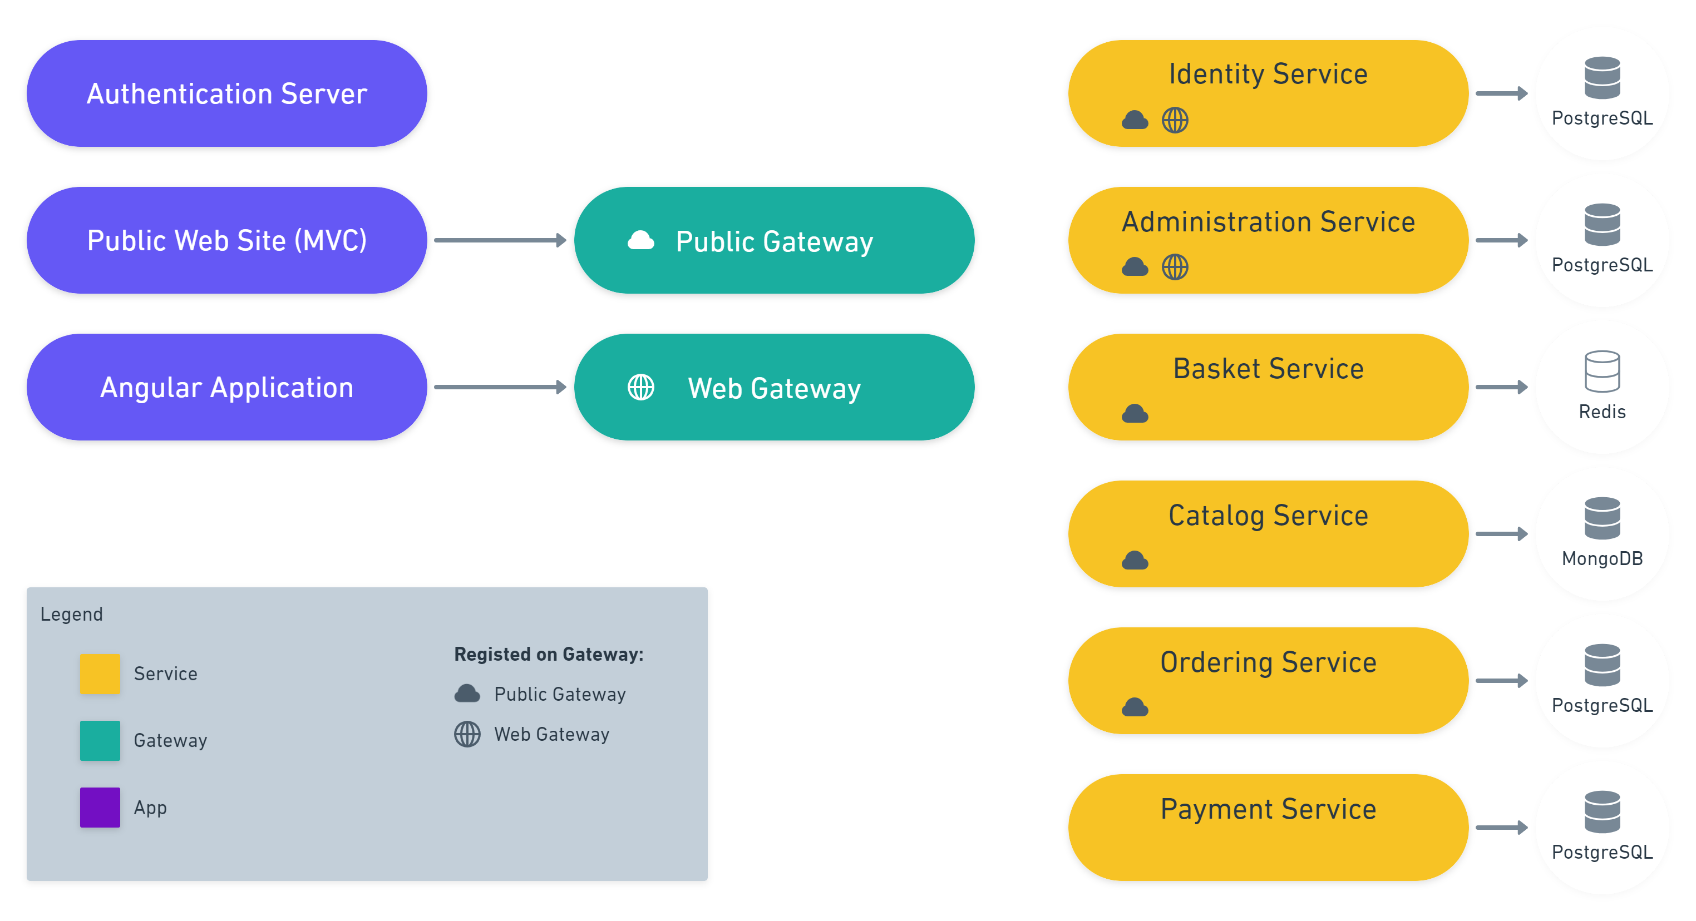
eShopOnAbo project
github.com/abpframework/eShopOnAbp

Slide 7
Communication in a monolithic application
Project dependencies / references
Dependency injection & method calls
Domain events (in-process)
Monolithic Application
Module - 1
Module - 2
Single Database
Module - 3
Module - 4
Module - 5
Module - 6

Slide 8
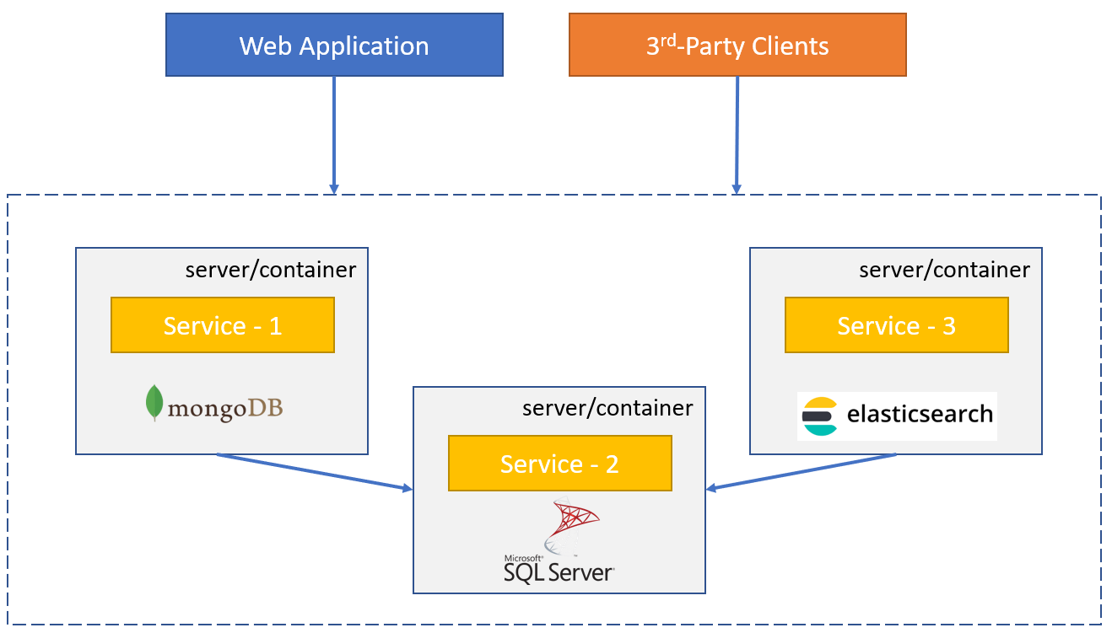
Communication in a microservice system
Synchronous communication: Service-to-service API calls (REST, gRPC, GraphQL, etc)
Asynchronous communication: Distributed events
Challenges:
Network delays / service downs
Security
Bottlenecks
Logging / tracing

Slide 9
Synchronous communication
Basket Microservice
Catalog Microservice
BasketService
IProductAppService
ProductController (auto)
ProductAppService Client Proxy
IProductAppService
REST
(retry)
Http Context
(access_token)
Get auth token
ProductAppService
(Real Implementation)
IProductRepository
IAuthenticator
OAuth
Catalog DB
Authentication Server

Slide 10
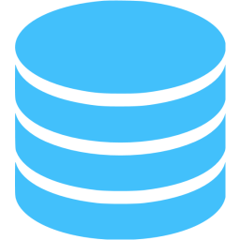
Asynchronous communication
Microservice A
Microservice B
event
Message Broker
(RabbitMQ, Kafka, etc)
event
application data
application data
re-connect
re-try
publish/subscribe
the transaction problem!

Slide 11
The transaction problem of distributed events
public void FooAsync()
{
/* Database operation 1 (on SQL Server) */
/* Publish event 1 (to RabbitMQ) */
/* Database operation 2 (on SQL Server) */
/* Publish event 2 (to RabbitMQ) */
}

Slide 12
The transaction problem of distributed events
public void FooAsync()
{
/* BEGIN database transaction */
/* Database operation 1 (on SQL Server) */
/* Publish event 1 (to RabbitMQ) */
/* Database operation 2 (on SQL Server) */
/* Publish event 2 (to RabbitMQ) */
/* COMMIT database transaction */
}

Slide 13
The transaction problem of distributed events
public void FooAsync()
{
/* BEGIN database transaction */
/* Database operation 1 (on SQL Server) */
/* Database operation 2 (on SQL Server) */
/* Publish event 1 (to RabbitMQ) */
/* Publish event 2 (to RabbitMQ) */
/* COMMIT database transaction */
}

Slide 14
The transaction problem of distributed events
public void FooAsync()
{
/* BEGIN database transaction */
/* Database operation 1 (on SQL Server) */
/* Database operation 2 (on SQL Server) */
/* Save event 1 (to outbox in SQL Server – to the same database) */
/* Save event 2 (to outbox in SQL Server – to the same database) */
/* COMMIT database transaction */
}

Slide 15
Distributed events with ABP v5.0
Microservice A
Microservice B
event
event
ABP Event Bus
Message Broker
(RabbitMQ, Kafka, etc)
ABP Event Bus
application data
application data
re-connect
re-try
publish/subscribe
background workers
auto-events
distributed locking
outbox/inbox
outbox/inbox

Slide 16
DEMO

Slide 17
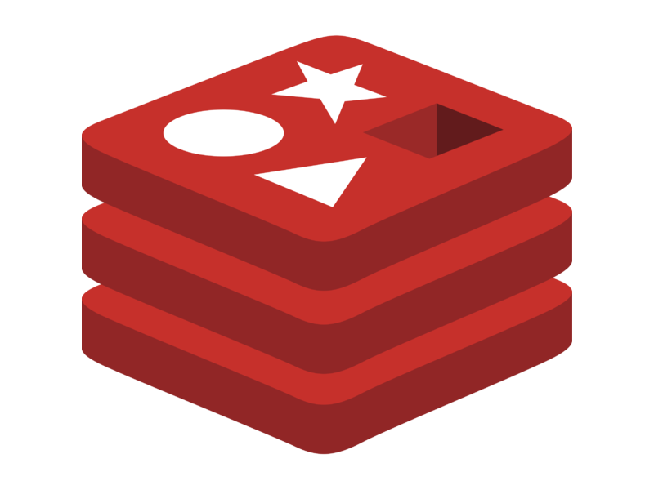
How it works: Add product to basket
ABP JavaScript Client Proxies
HTTP Proxying
Routing
JavaScript (on browser)
YARP (on web app)
Ocelot (API Gateway)
BasketService
redis
ABP C# Client Proxies
CatalogService
PostgreSQL

Slide 18
How it works: Product -> Basket update
PostgreSQL
redis
JavaScript SignalR Client
ABP Angular Client Proxies
Routing
ABP C# Client Proxies
ABP C# Client Proxies
SignalR WebSocket Connection
Admin UI (angular)
Ocelot (API Gateway)
CatalogService
BasketService
Web App
ABP Publishes Events
ABP Subscribes to the Events
Event Bus (RabbitMQ)

Slide 19
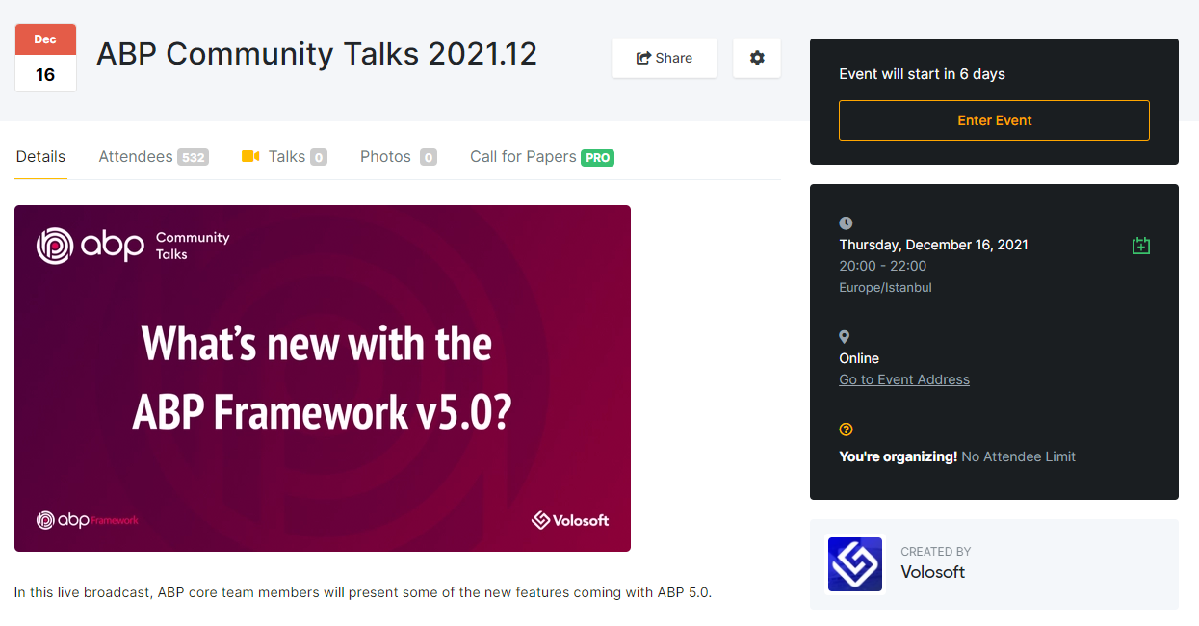
https://kommunity.com/volosoft/events/abp-community-talks-4afca9c9
https://www.youtube.com/watch?v=uLu2t5E8T-w

Slide 20
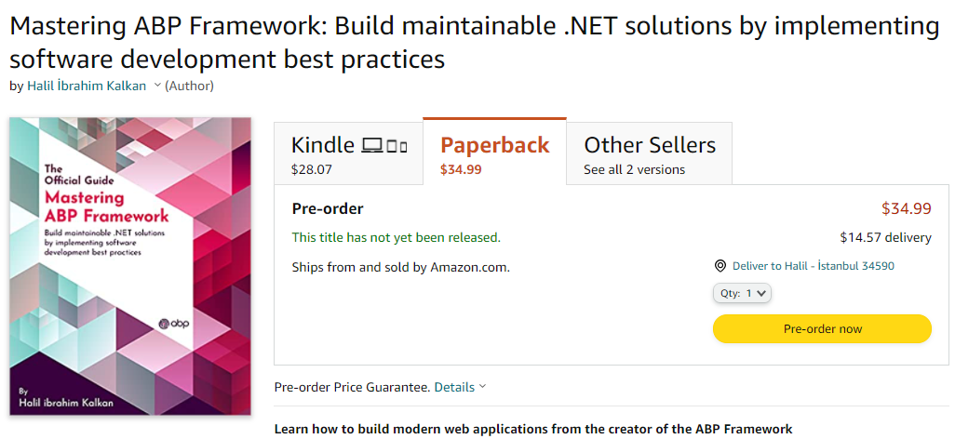
https://www.amazon.com/gp/product/B097Z2DM8Q

Slide 21
Microservice Communication with the ABP Framework
QUESTIONS?
The presentation: https://github.com/hikalkan/presentations Source code:
https://github.com/abpframework/eShopOnAbp/tree/ms-comm-demo
ABP Framework
Halil İbrahim KALKAN
Web: abp.io Github: /abpframework
Twitter: @abpframework
Web: halilibrahimkalkan.com Github: /hikalkan
Twitter: @hibrahimkalkan
www.abp.io

Slide 22
Title
Content 1

